Slide 1
Deep learning to big data analytics on apache spark* using bigdl
Zhichao (zhichao.li@intel.com)
Big Data Technology, Software and Service Group, Intel

Slide 2
Outline
BigDL
Apache Spark* + High Performance + Deep Learning
Speech recognition:
Deep Speech 2 on BigDL: ML Pipeline + BigDL
Object detection:
Faster RCNN and SSD on BigDL

Slide 3
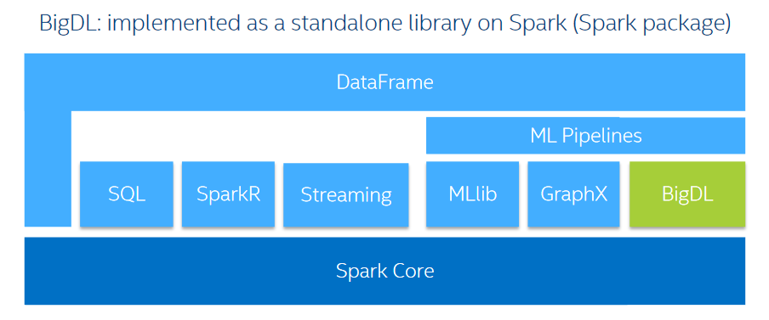
What is BigDL?
BigDL is a distributed deep learning library for Apache Spark*

Slide 4

BigDL: Deep learning on Apache Spark*
BigDL open sourced on Dec 30, 2016
Apache Spark*, MKL Acceleration, High performance
Rich function
AlexNet, GoogleNet, VGG, Faster R-CNN, SSD, Deep Speech, Recommendation…
Scala/Java + Python
AWS EC2, TensorBoard, Notebook, caffe/torch load/export…
Popularity
Support from Cloud: Microsoft, Amazon, Cloudera, Databricks…
Community. 1700+ stars

Slide 5
Basic Component
Layers
113+ layers (Conv, 3D Conv, Pooling, 3D Pooling, FC …)
Criterion
23+ criterions (DiceCoefficient, ClassNLL, CrossEntropy …)
Optimization
SGD, Adagrad, LBFGS
Community contribution: Adam, Adadelta, RMSprop, Adamx
Tensor:
ND-array data structure
Generic data type
Rich and fast math operations (powered by Intel MKL)

Slide 6
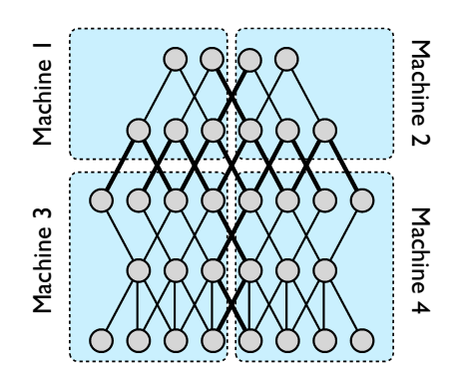
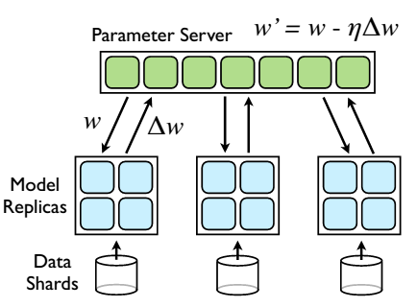
Pattern
Model Parallelism
Data Parallelism
Source: Dean J, Corrado G, Monga R, et al. Large scale distributed deep networks[C]//Advances in neural information processing systems. 2012: 1223-1231.

Slide 7
Communication Model
Task
Task
Driver
Task
Task
Task
Task
All to one
Parameter Server
11
10
35
Task
35
14
4
7
2
35
Task
Task
35
35
35
5
1
35
6
2
5
1
6
Task
All reduce (tree aggregation)
All reduce

Slide 8
Bulk Synchronous Parallel (BSP)
worker1
1
2
3
worker2
1
2
3
worker3
1
2
3
worker4
1
2
3

Slide 9
Asynchronous Synchronous Parallel (ASP)
worker1
1
2
worker2
1
2
3
4
5
worker3
1
2
3
worker4
1
2
3
4
Source: Dean J, Corrado G, Monga R, et al. Large scale distributed deep networks[C]//Advances in neural information processing systems. 2012: 1223-1231.

Slide 10
Distributed deep neural network on Spark
Data shards
Data shards
Utilize Spark to Scale out on multiple CPU cluster
Trainer synchronize to each other through All-reduce or ParameterServer
CPU
CPU
CPU
CPU
CPU
CPU
CPU
CPU
CPU
CPU
BigDL
BigDL
All-reduce or ParameterServer
Spark

Slide 11
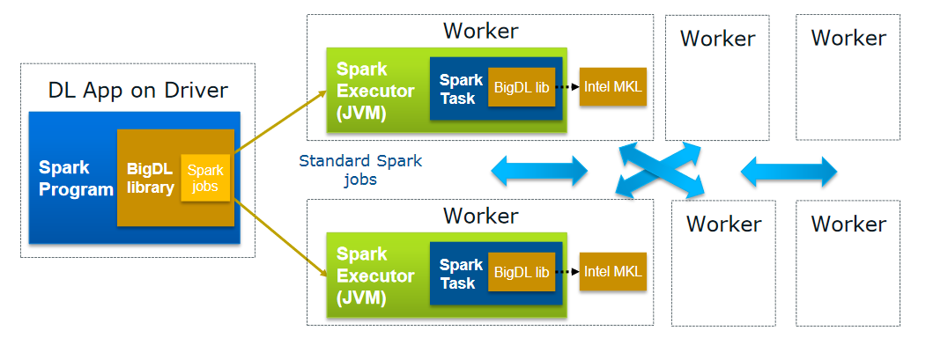
Run as standard Apache Spark* jobs

Slide 12
Deep SPEECH 2 with BIGDL

Slide 13
Speech Recognition
Challenges
Audio → text
Speaker variability, Channel variability, Different languages
Solutions:
Hybrid system:
DNNs, Hidden Markov Models (HMMs), context-dependent phone models, Lexicon models, GMM.
Domain expertise and multi-stage
DNN end to end:
DNN. Much easier
More data, better model

Slide 14
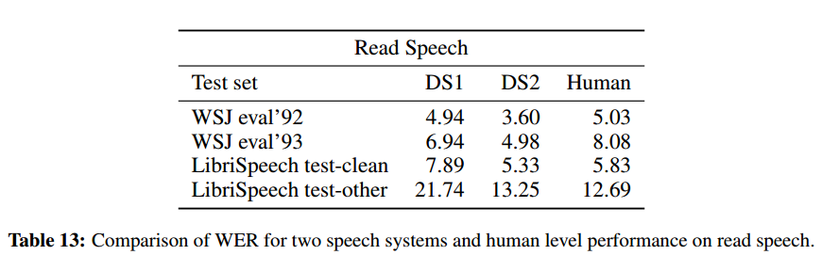
Deep Speech 2 for Speech Recognition
“The Deep Speech 2 ASR pipeline approaches or exceeds the accuracy of Amazon Mechanical Turk human workers on several benchmarks, works in multiple languages with little modification, and is deployable in a production setting.”
“Table 13 shows that the DS2 system outperforms humans in 3 out of the 4 test sets and is competitive on the fourth. Given this result, we suspect that there is little room for a generic speech system to further improve on clean read speech without further domain adaptation.”
https://arxiv.org/pdf/1512.02595.pdf

Slide 15
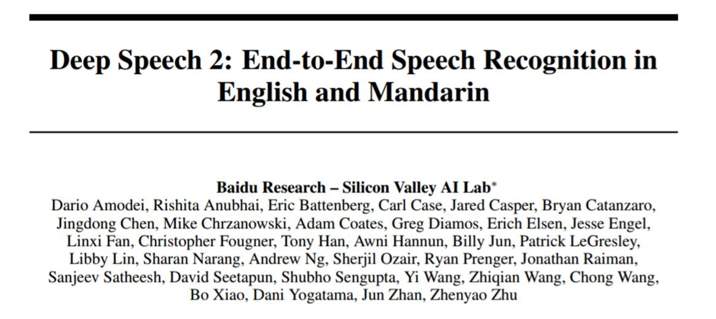
Deep Speech 2 on BigDL

Slide 16
Deep Speech 2 on BigDL: Feature transformers
Apache Spark* ML Pipeline

Slide 17
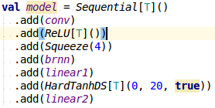
Deep Speech 2 on BigDL: Model
9 layers biRNN: >50 Million parameters

Slide 18
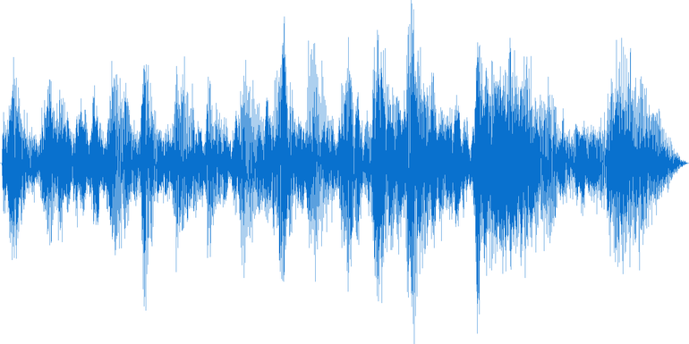
Deep Speech 2 on BigDL: CTC Loss
Connectionist Temporal Classification
a loss function useful for performing supervised learning on sequence data, without needing an alignment between input data and labels. (Alex Graves etc. 2006)
Raw waveforms and text transcription
BigDL developed first open source CTC on Java/Scala
Loss/Gradient in consistency with baidu/warp-ctc
JNI version about 3X faster than Scala version, but CTC only takes 0.2% of the training time.
“…BigDL help users run deep learning on Spark…”
http://www.cs.toronto.edu/~graves/icml_2006.pdf

Slide 19
Deep Speech 2 on BigDL: Model training
With libriSpeech, 5 RNN layer, 30 seconds uttLength, 30 epoches.

Slide 20
Deep Speech 2 on BigDL: Decoder
 | t1 | t2 | t3 | t4 | …
A | 0.01 | 0.1 | 0.7 | 0.03
B | 0.05 | 0.01 | 0.2 | 0.5
C | 0.01 | 0.1 | 0.09 | 0.01
D | 0.8 | 0.05 | 0.01 | 0.01
… | … | … | … | …
Blank | 0.1 | 0.6 | 0.01 | 0.4
 | D | - | A | B
Existing decoder:
BestPathDecoder (argmax) wer = 27%
VocabDecoder wer = 22%
Contribution welcome
decoder with Language Model, expect wer < 10%
Notes:
weighted finite state transducers (WFSTs)

Slide 21
Deep Speech 2 with AN4 data
Deep Speech 2 (8 layer, 5 RNN), uttLength 8 seconds
Word Error Rate with hold-out validation dataset
 | wer(without LM)
Deep Speech on Tensorflow | 12.4%
BigDL | < 5%

Slide 22
Deep Speech 2 with LibriSpeech
Deep Speech 2 (12 layers, 9 RNN), uttLength 30 seconds
Word Error Rate with hold-out validation dataset
Still under further tuning and optimization.
More training data
Optimizer (Adam, SGD, nesterov )
 | cer | wer(without LM)
Hannun, et al. (2014) | 10.7 | 35.8
Graves-Jaitly (ICML 2014) | 9.2 | 30.1
Hwang-Sung (ICML 2016) | 10.6 | 38.4
BigDL | 8.7 | 32.4

Slide 23
Deep Speech 2 on BigDL: Summary
Feature transformers:
Flac/wav Reader, Windower, TimeSegmenter, TranscriptVectorizer, DFTSpecgram, MelFrequencyFilterBank
Model training and inference
Big DL container, optimizer, Convolution, BatchNormalization, Bi-RNN
CTC (Connectionist Temporal Classification) loss
Scala or JNI (warp-ctc)
Decoder
ArgmaxDecoder, VocabDecoder
Evaluation
wer, cer

Slide 24
Object Detection with BIGDL

Slide 25
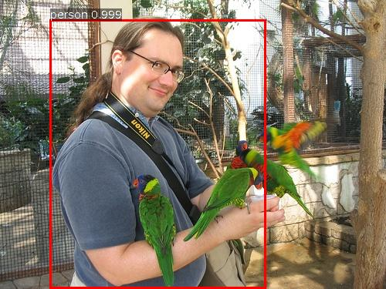
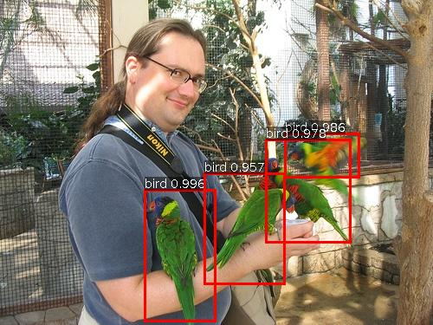
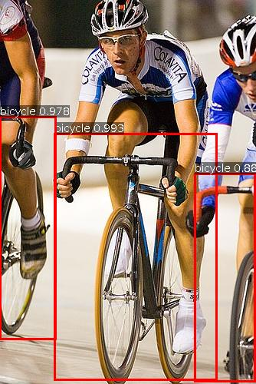
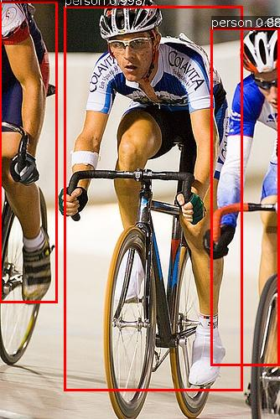
SSD: Single Shot Multibox Detector
State-of-the-art object detection pipeline
Single shot
Liu, Wei, et al. "SSD: Single shot multibox detector." European Conference on Computer Vision. Springer International Publishing, 2016.
Images from PASCAL(http://host.robots.ox.ac.uk/pascal/VOC/)

Slide 26
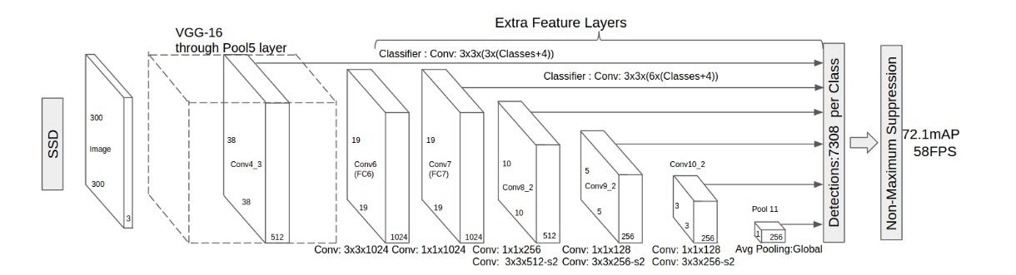
The Single Shot Detector (SSD)
Convolutional predictors for detection
base network
fc6 and fc7 converted to convolutional
collection of bounding boxes and scores for each category
Multi-scale feature maps for detection: observe how conv feature maps decrease in size and allow predictions at multiple scales
https://arxiv.org/abs/1512.02325

Slide 27
SSD Pipeline
RDD[ByteImage]
Raw Data
Pre-trained Model
prediction
Visualizer
Preprocess
Resize
BigDL SSD Model
Post-processor
Boxes & scores
Normalize
RDD[Tensor]
ToBatch
Ground Truth
MAP
Validation

Slide 28
SSD + VGG 300x300 test over Pascal VOC 2007
SSD + VGG 300x300 with pretrained model over voc07+12
Mean Average Precision
 | Caffe Model | BigDL
MAP | 77.2 | 77.3

Slide 29
SSD + VGG 512x512 test over Pascal VOC 2007
SSD + VGG 512x512 with pretrained model over voc07+12
Mean Average Precision
 | Caffe Model | BigDL
MAP | 79.6 | 79.6

Slide 30
BigDL Community
analytics-zoo
https://github.com/intel-analytics/analytics-zoo
Join Our Mail List
bigdl-user-group+subscribe@googlegroups.com
Report Bugs And Create Feature Request
https://github.com/intel-analytics/BigDL/issues

Slide 32
Legal Disclaimer
INFORMATION IN THIS DOCUMENT IS PROVIDED IN CONNECTION WITH INTEL PRODUCTS. NO LICENSE, EXPRESS OR IMPLIED, BY ESTOPPEL OR OTHERWISE, TO ANY INTELLECTUAL PROPERTY RIGHTS IS GRANTED BY THIS DOCUMENT. EXCEPT AS PROVIDED IN INTEL'S TERMS AND CONDITIONS OF SALE FOR SUCH PRODUCTS, INTEL ASSUMES NO LIABILITY WHATSOEVER AND INTEL DISCLAIMS ANY EXPRESS OR IMPLIED WARRANTY, RELATING TO SALE AND/OR USE OF INTEL PRODUCTS INCLUDING LIABILITY OR WARRANTIES RELATING TO FITNESS FOR A PARTICULAR PURPOSE, MERCHANTABILITY, OR INFRINGEMENT OF ANY PATENT, COPYRIGHT OR OTHER INTELLECTUAL PROPERTY RIGHT.
A "Mission Critical Application" is any application in which failure of the Intel Product could result, directly or indirectly, in personal injury or death. SHOULD YOU PURCHASE OR USE INTEL'S PRODUCTS FOR ANY SUCH MISSION CRITICAL APPLICATION, YOU SHALL INDEMNIFY AND HOLD INTEL AND ITS SUBSIDIARIES, SUBCONTRACTORS AND AFFILIATES, AND THE DIRECTORS, OFFICERS, AND EMPLOYEES OF EACH, HARMLESS AGAINST ALL CLAIMS COSTS, DAMAGES, AND EXPENSES AND REASONABLE ATTORNEYS' FEES ARISING OUT OF, DIRECTLY OR INDIRECTLY, ANY CLAIM OF PRODUCT LIABILITY, PERSONAL INJURY, OR DEATH ARISING IN ANY WAY OUT OF SUCH MISSION CRITICAL APPLICATION, WHETHER OR NOT INTEL OR ITS SUBCONTRACTOR WAS NEGLIGENT IN THE DESIGN, MANUFACTURE, OR WARNING OF THE INTEL PRODUCT OR ANY OF ITS PARTS.
Intel may make changes to specifications and product descriptions at any time, without notice. Designers must not rely on the absence or characteristics of any features or instructions marked "reserved" or "undefined". Intel reserves these for future definition and shall have no responsibility whatsoever for conflicts or incompatibilities arising from future changes to them. The information here is subject to change without notice. Do not finalize a design with this information.
The products described in this document may contain design defects or errors known as errata which may cause the product to deviate from published specifications. Current characterized errata are available on request.
Contact your local Intel sales office or your distributor to obtain the latest specifications and before placing your product order.
Copies of documents which have an order number and are referenced in this document, or other Intel literature, may be obtained by calling 1-800-548-4725, or go to: http://www.intel.com/design/literature.htm
Intel, Quark, VTune, Xeon, Cilk, Atom, Look Inside and the Intel logo are trademarks of Intel Corporation in the United States and other countries.
*Other names and brands may be claimed as the property of others.
Copyright ©2015 Intel Corporation.

Slide 33
Risk Factors
The above statements and any others in this document that refer to plans and expectations for the first quarter, the year and the future are forward-looking statements that involve a number of risks and uncertainties. Words such as “anticipates,” “expects,” “intends,” “plans,” “believes,” “seeks,” “estimates,” “may,” “will,” “should” and their variations identify forward-looking statements. Statements that refer to or are based on projections, uncertain events or assumptions also identify forward-looking statements. Many factors could affect Intel’s actual results, and variances from Intel’s current expectations regarding such factors could cause actual results to differ materially from those expressed in these forward-looking statements. Intel presently considers the following to be the important factors that could cause actual results to differ materially from the company’s expectations. Demand could be different from Intel's expectations due to factors including changes in business and economic conditions; customer acceptance of Intel’s and competitors’ products; supply constraints and other disruptions affecting customers; changes in customer order patterns including order cancellations; and changes in the level of inventory at customers. Uncertainty in global economic and financial conditions poses a risk that consumers and businesses may defer purchases in response to negative financial events, which could negatively affect product demand and other related matters. Intel operates in intensely competitive industries that are characterized by a high percentage of costs that are fixed or difficult to reduce in the short term and product demand that is highly variable and difficult to forecast. Revenue and the gross margin percentage are affected by the timing of Intel product introductions and the demand for and market acceptance of Intel's products; actions taken by Intel's competitors, including product offerings and introductions, marketing programs and pricing pressures and Intel’s response to such actions; and Intel’s ability to respond quickly to technological developments and to incorporate new features into its products. The gross margin percentage could vary significantly from expectations based on capacity utilization; variations in inventory valuation, including variations related to the timing of qualifying products for sale; changes in revenue levels; segment product mix; the timing and execution of the manufacturing ramp and associated costs; start-up costs; excess or obsolete inventory; changes in unit costs; defects or disruptions in the supply of materials or resources; product manufacturing quality/yields; and impairments of long-lived assets, including manufacturing, assembly/test and intangible assets. Intel's results could be affected by adverse economic, social, political and physical/infrastructure conditions in countries where Intel, its customers or its suppliers operate, including military conflict and other security risks, natural disasters, infrastructure disruptions, health concerns and fluctuations in currency exchange rates. Expenses, particularly certain marketing and compensation expenses, as well as restructuring and asset impairment charges, vary depending on the level of demand for Intel's products and the level of revenue and profits. Intel’s results could be affected by the timing of closing of acquisitions and divestitures. Intel's results could be affected by adverse effects associated with product defects and errata (deviations from published specifications), and by litigation or regulatory matters involving intellectual property, stockholder, consumer, antitrust, disclosure and other issues, such as the litigation and regulatory matters described in Intel's SEC reports. An unfavorable ruling could include monetary damages or an injunction prohibiting Intel from manufacturing or selling one or more products, precluding particular business practices, impacting Intel’s ability to design its products, or requiring other remedies such as compulsory licensing of intellectual property. A detailed discussion of these and other factors that could affect Intel’s results is included in Intel’s SEC filings, including the company’s most recent reports on Form 10-Q, Form 10-K and earnings release.

